Slide 1
Chapter 3
The Pandas essentials for data visualization

Slide 2
Objectives (part 1)
Applied
Use the Pandas plot() method to create these types of plots:
line plot area plot scatter plot bar plot histogram density plot box plot pie plot
Use the parameters of the Pandas plot() method to enhance a plot in these ways:
add a title, x and y labels, and grid lines
rotate the tick labels
set the x- and y-axis limits

Slide 3
Objectives (part 2)
Use the parameters of the Pandas plot() method to create a plot that has subplots.
Chain the Pandas plot() method to methods that prepare the data for the plot() method.
Knowledge
List three data visualization libraries for Python.
Distinguish between long data and wide data and describe their effects on the Pandas plot() method.
Describe the way the Pandas plot() method works when no parameters are coded.

Slide 4
Objectives (part 3)
Describe these types of plots:
line plot scatter plot bar plot histogram box plot

Slide 5
Data visualization libraries for Python
matplotlib
pandas
seaborn
altair
ggplot
Data visualization can help you…
Understand your data more easily.
See the relationships between variables.
Spot unusual datapoints like outliers.

Slide 6
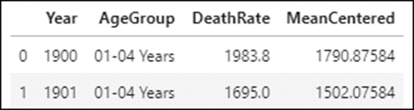
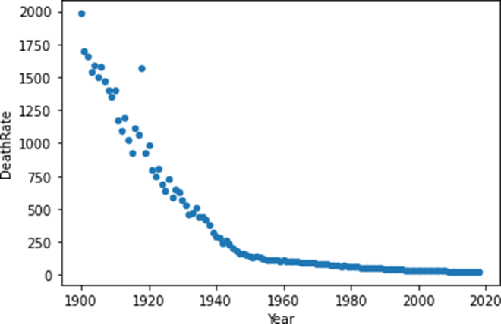
The mortality data in long form (mortality_data)
A scatter plot derived from the long data
mortality_data.query('AgeGroup == "01-04 Years"') \ .plot.scatter(x='Year', y='DeathRate')

Slide 7
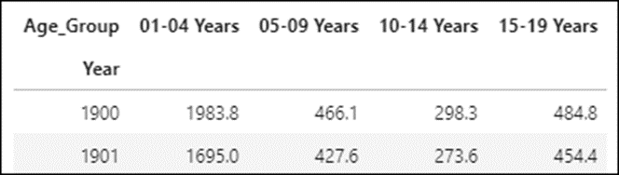
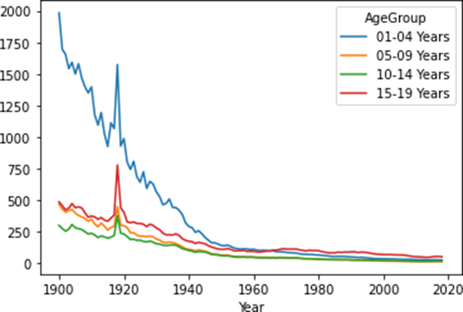
The mortality data in wide form with Year as the index (mortality_wide)
A line plot derived from the wide data
mortality_wide.plot()

Slide 8
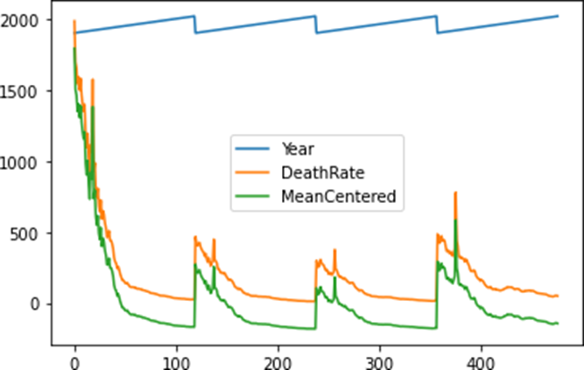
A plot() method that plots the long data with no parameters
mortality_data.plot()

Slide 9

A plot() method that plots the wide data with no parameters
mortality_wide.plot()

Slide 10
The three basic parameters for the Pandas plot() method
Parameter | Description
x | The column to be plotted on the x-axis. This column can’t be in an index.
y | The column or list of columns to be plotted on the y-axis.
kind | The kind of plot to be displayed. The default is ‘line’.

Slide 11

How to code the plot() method without using the kind parameter
mortality_data.plot.scatter() # same as plot(kind='scatter')
mortality_data.plot.bar() # same as plot(kind='bar')
How to create a scatter plot from the long data
mortality_data.query('AgeGroup == "01-04 Years"') \ .plot.scatter(x='Year', y='DeathRate')

Slide 12
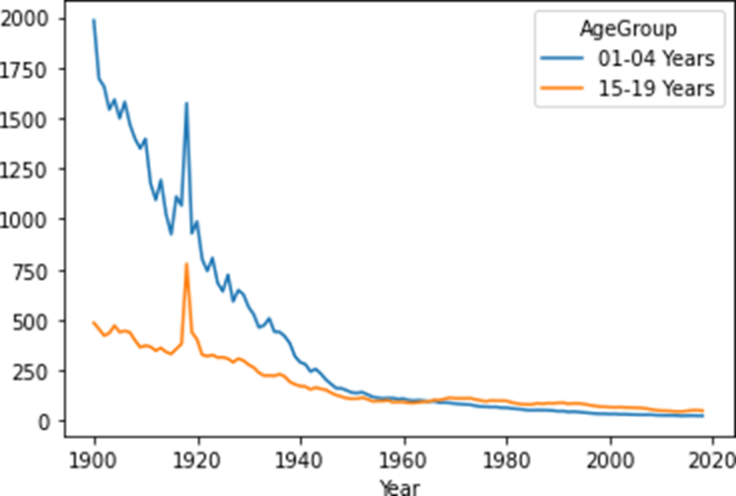
How to create a line plot from the wide data for just two of the columns
mortality_wide.plot.line(y=['01-04 Years','15-19 Years'])

Slide 13
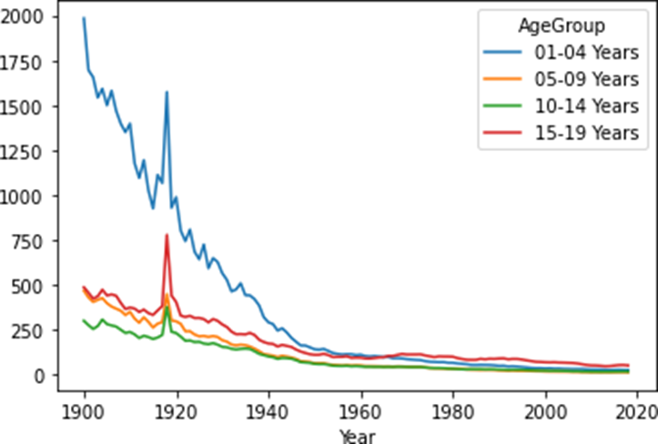
How to create a line plot from wide data
mortality_wide.plot.line()

Slide 14
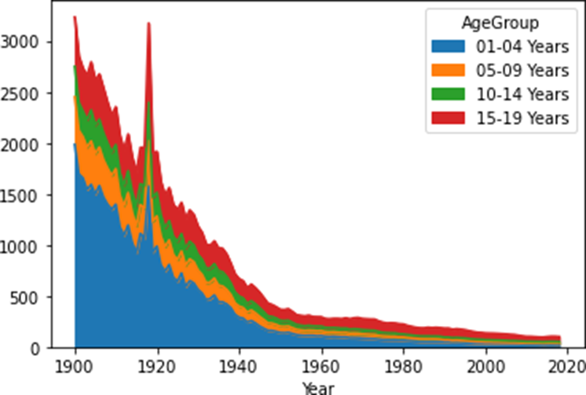
How to create an area plot from wide data
mortality_wide.plot.area()

Slide 15
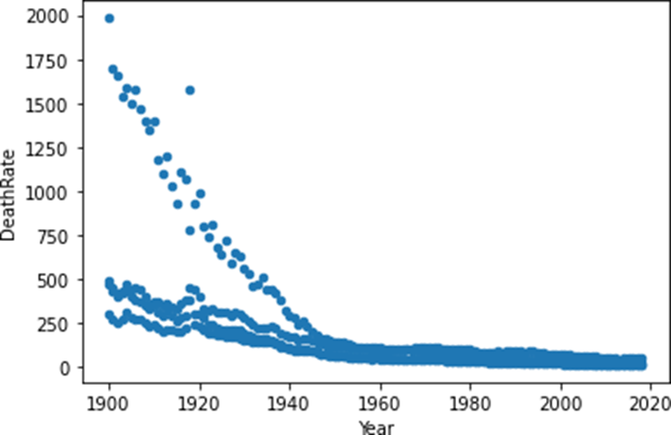
How to create a scatter plot from long data
mortality_data.plot.scatter(x='Year', y='DeathRate')

Slide 16
Common problems with scatter plots based on wide data
You have to code both x and y parameters
mortality_wide.plot.scatter()
-----------------------------
TypeError: scatter() missing 2 required positional arguments: 'x' and 'y'
The x parameter can’t be in an index
mortality_wide.plot.scatter(x='Year', y='DeathRate')
----------------------------------------------------
KeyError: 'Year'

Slide 17
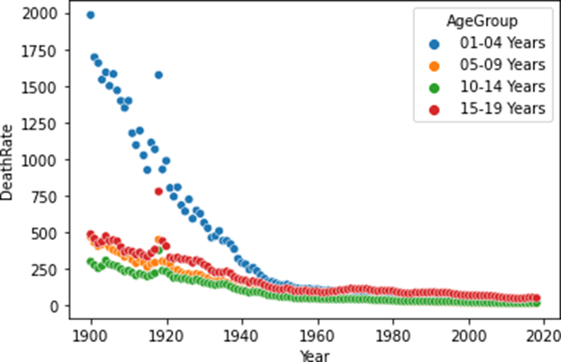
How Seaborn improves on Pandas
import seaborn as sns
sns.scatterplot(data=mortality_data, x='Year', y='DeathRate', hue='AgeGroup')

Slide 18
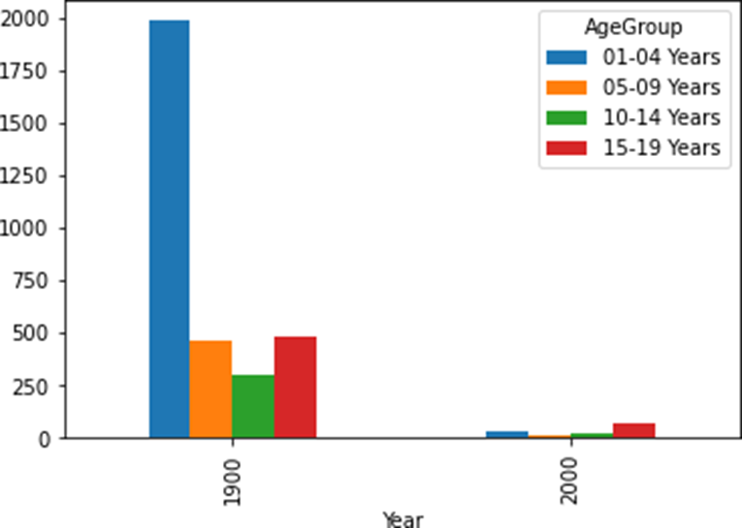
How to create a vertical bar plot from the wide data
mortality_wide.query('Year in (1900,2000)').plot.bar()

Slide 19
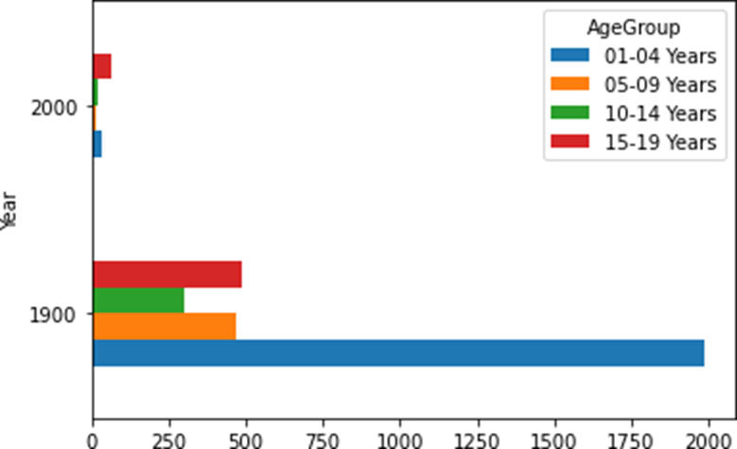
How to create a horizontal bar plot from the wide data
mortality_wide.query('Year in (1900,2000)').plot.barh()

Slide 20
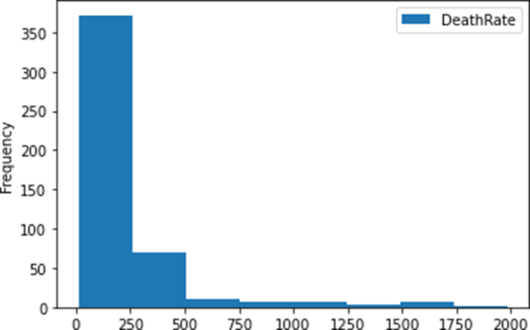
How to create a histogram
mortality_data.plot.hist(y='DeathRate', bins=8)

Slide 21
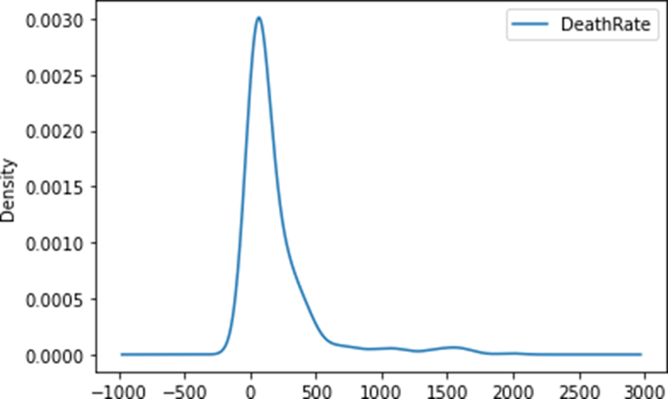
How to create a density plot
mortality_data.plot.density(y='DeathRate')

Slide 22
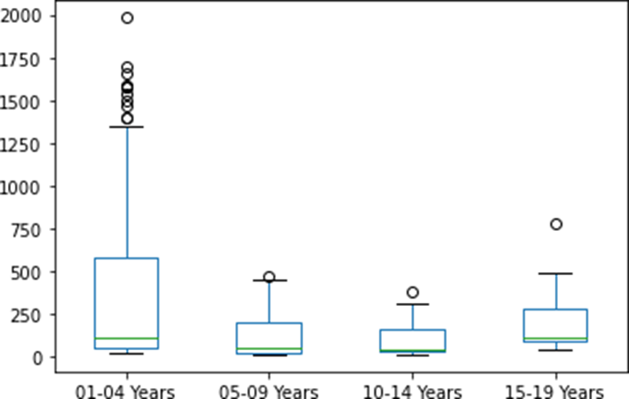
How to create a box plot from the wide data
mortality_wide.plot.box()

Slide 23
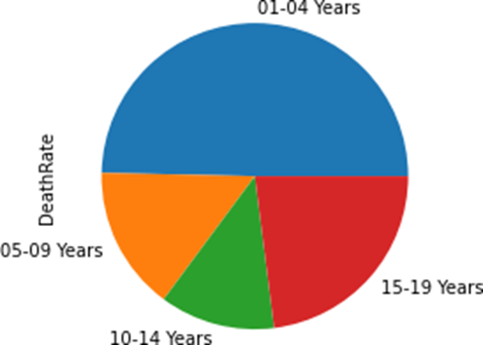
How to create a pie plot from the long data
mortality_data.groupby('AgeGroup')['DeathRate'].sum().plot.pie()

Slide 24
Some of the parameters for the Pandas plot() method
Parameter | Description
title | The title of the plot.
legend | If False, the legend isn’t displayed. If ‘reverse’, the legend items are displayed in reverse order.
grid | If True, displays gridlines.
rot | The rotation of the tick labels from 0 (the default) to 360.
xlabel, ylabel | The label for the x- or y-axis.
xlim, ylim | Tuples that set the range for the x- or y-axis.
figsize | A tuple that sets the width and height of the plot in inches.

Slide 25
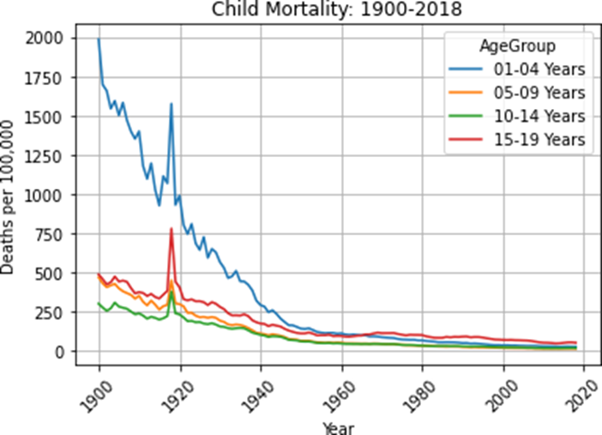
A plot with a title and a grid
mortality_wide.plot.line(title='Child Mortality: 1900-2018',
ylabel='Deaths per 100,000',
grid=True, rot=45)

Slide 26
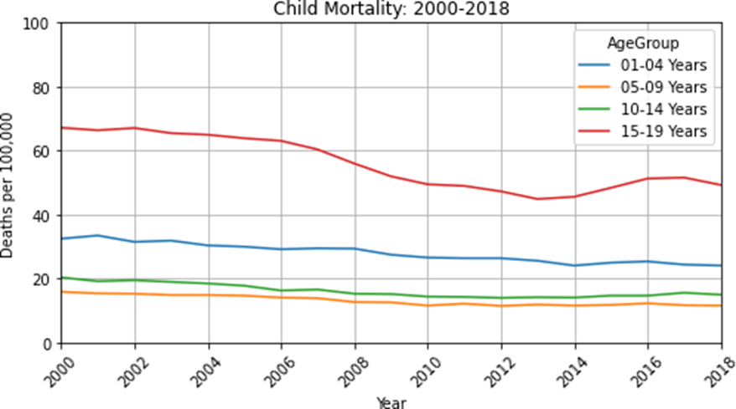
A plot with x and y limits
mortality_wide.plot.line(title='Child Mortality: 2000-2018',
ylabel='Deaths per 100,000', figsize=(8,4), grid=True,
rot=45, xlim=(2000,2018), ylim=(0,100))

Slide 27
The Pandas parameters for working with subplots
Parameter | Description
title | A string for the plot title or a list of strings for the subplot titles.
subplots | If True, creates subplots if the y-axis plots more than one Series.
layout | A tuple that sets the number of rows and columns for the subplots.
sharex, sharey | If True, shares the label for the x- or y-axis so it won’t be repeated for each subplot. By default, sharex is True, sharey is False.

Slide 28
A plot with four subplots
mortality_wide.plot.line(
title=['Child Mortality: 01-04','Child Mortality: 05-09',
'Child Mortality: 10-14','Child Mortality: 15-19'],
ylabel='Deaths per 100,000', sharey=True,
grid=True, rot=45, xlim=(1900,1950), legend=False,
subplots=True, layout=(2,2), figsize=(10,10))

Slide 29
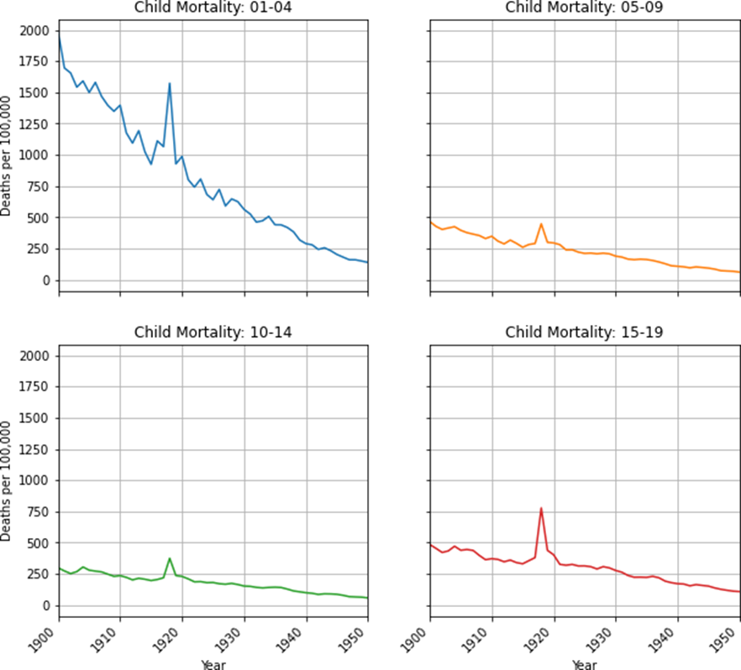
A plot with four subplots (continued)

Slide 30
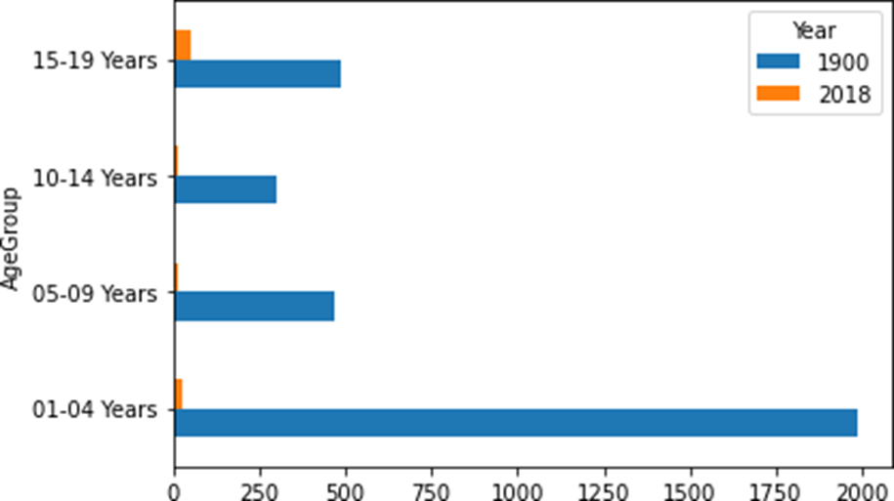
How to use chaining to create a bar plot from long data
mortality_data.query('Year in (1900,2018)') \
.pivot(index='AgeGroup', columns='Year',
values='DeathRate').plot.barh()

Slide 31
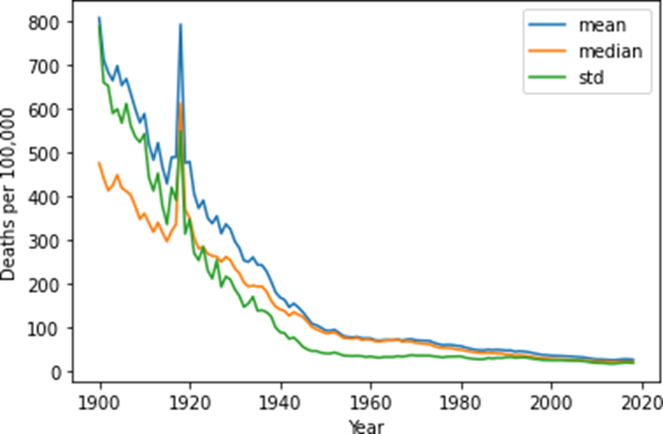
How to use the groupby() method and chaining to create a plot
mortality_data.groupby('Year')['DeathRate'] \
.agg(['mean','median','std']) \
.plot(ylabel='Deaths per 100,000')

